Slide 1

Analyzing Students' Perceptions of AI and Academic Performance
Michael Ferrell

Slide 2
Problem
How does AI impact the performance of students?
Is this influenced by their knowledge or feelings towards AI?
Are key competencies such as critical thinking, problem-solving, or creativity impacted?
Notes:
The central problem addressed in this study is understanding the students' perspective of AI in an educational setting. Where possible, a focus is maintained on the impact to critical thinking, problem-solving, and creativity. The study seeks to answer whether AI aids or hinders these crucial competencies, how schools are preparing students to work with AI, and the overall perception of AI in educational settings from both students and teachers. Additionally, the study aims to uncover any demographic influences on AI perception and the correlation between AI usage and academic performance.

Slide 3
Dataset and Variables
Survey on Students' Perceptions of AI in Education - Kaggle
USA_GPA: Students' GPA on a 0-4 scale.
Perceived_Understanding: Self-assessed understanding of AI on a scale from 1 to 10.
Primary_Advantage: Grading automation/Grading accuracy/Student virtual assistance/Other.
Primary_Disadvantage: Teacher-student disconnect/Internet addiction/Reduced teacher-student interactions/Information loss.
All_Exams_Passed: Whether the student has passed all exams (Yes/No).
Notes:
Dataset: Description of the dataset from Kaggle - Survey on Students' Perceptions of AI in Education.
Variables:
USA_GPA: Students' GPA on a 0-4 scale.
Perceived_Understanding: Self-assessed understanding of AI on a scale from 1 to 10.
Primary_Advantage: The perceived primary advantage of AI in education.
Primary_Disadvantage: The perceived primary disadvantage of AI in education.
All_Exams_Passed: Whether the student has passed all exams (Yes/No).

Slide 4
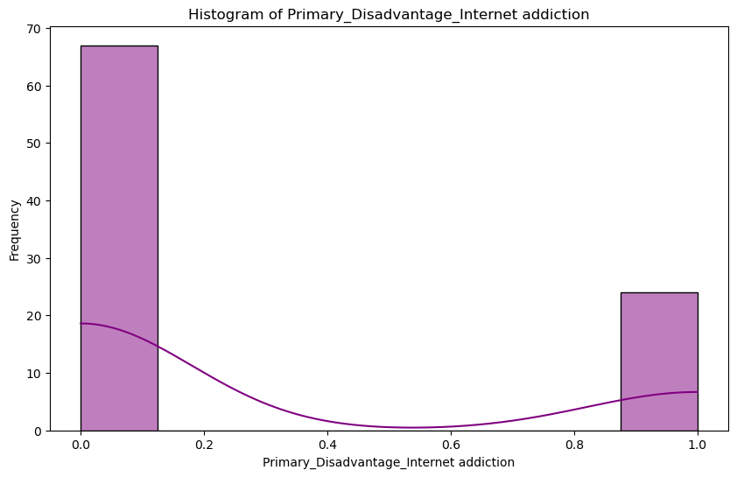
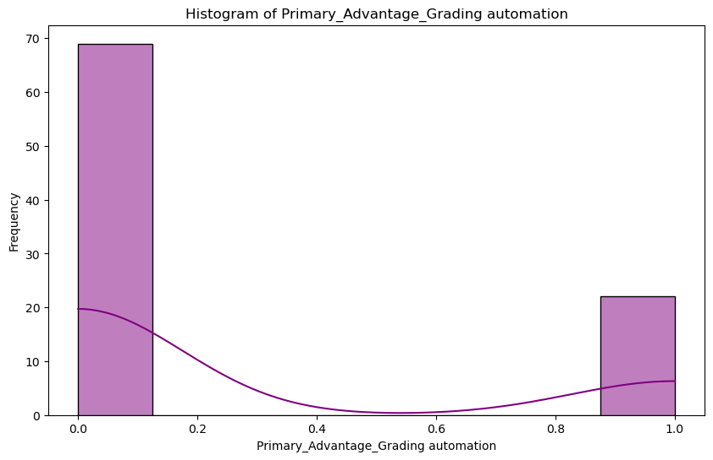
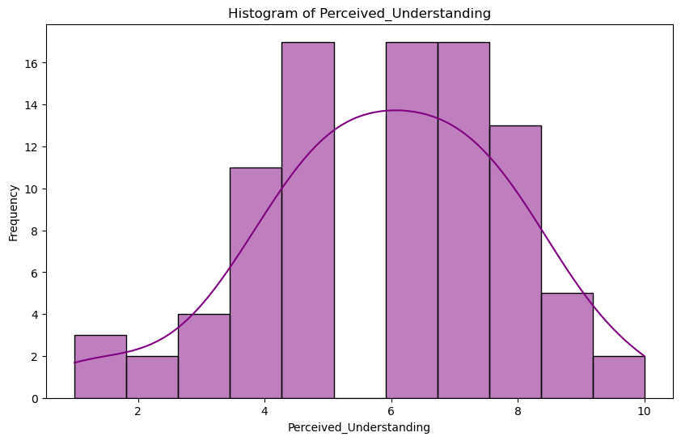
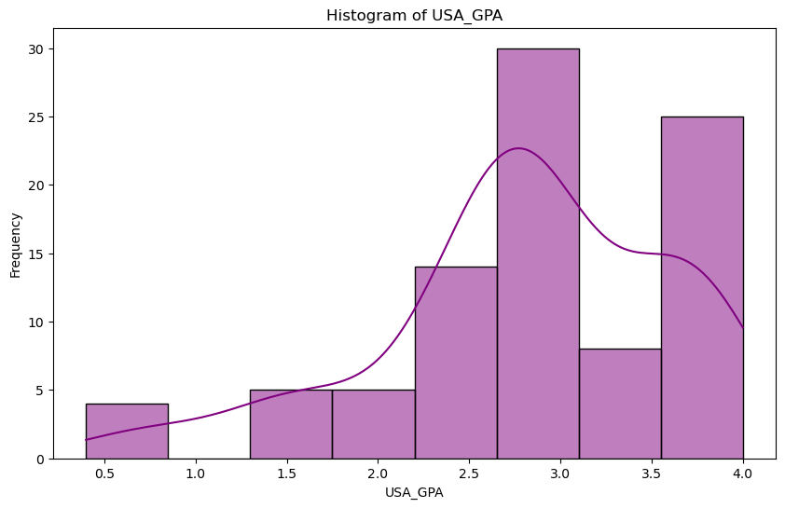
Histograms and Descriptive Statistics
Histogram of Primary Disadvantage: Internet Addiction
Mean: 0.26
Mode: 0
Standard Deviation: 0.44
Much like the advantages in grading automation, a disadvantage being internet addiction is not widely shared.
Histogram of Primary Advantage Grading Automation
Mean: 0.24
Mode: 0
Standard Deviation: 0.43
The results reveal most respondents do not perceive grading automation as a significant advantage, as evidenced by the high frequency of responses at zero, indicating skepticism or lack of awareness about its benefits. This may be situationally beneficial, but not desirable in all cases.
Histogram of Perceived Understanding
Mean: 5.91
Mode: 5.0
Standard Deviation: 1.97
It is clear that the majority of students rate their understanding around a moderate to high level, with a peak around the mid-point, reflecting a generally positive self-assessment of comprehension, though there are some
who feel less confident.
Histogram of USA GPA
Mean: 2.80
Mode: 2.8
Standard Deviation: 0.80
This histogram indicates that most students' GPAs are clustered around the 2.8 mark, suggesting a central
tendency towards average performance, with a notable number of lower GPA outliers, highlighting areas for potential academic support.

Slide 5
Histograms and Descriptive Statistics
Histogram of Primary Disadvantage: Internet Addiction
Mean: 0.26
Mode: 0
Standard Deviation: 0.44
Much like the advantages in grading automation, a disadvantage being internet addiction is not widely shared.
Histogram of Primary Advantage Grading Automation
Mean: 0.24
Mode: 0
Standard Deviation: 0.43
The results reveal most respondents do not perceive grading automation as a significant advantage, as evidenced by the high frequency of responses at zero, indicating skepticism or lack of awareness about its benefits. This may be situationally beneficial, but not desirable in all cases.
Histogram of Perceived Understanding
Mean: 5.91
Mode: 5.0
Standard Deviation: 1.97
It is clear that the majority of students rate their understanding around a moderate to high level, with a peak around the mid-point, reflecting a generally positive self-assessment of comprehension, though there are some
who feel less confident.
Histogram of USA GPA
Mean: 2.80
Mode: 2.8
Standard Deviation: 0.80
This histogram indicates that most students' GPAs are clustered around the 2.8 mark, suggesting a central
tendency towards average performance, with a notable number of lower GPA outliers, highlighting areas for potential academic support.

Slide 6
Histograms and Descriptive Statistics
Histogram of Primary Disadvantage: Internet Addiction
Mean: 0.26
Mode: 0
Standard Deviation: 0.44
Much like the advantages in grading automation, a disadvantage being internet addiction is not widely shared.
Histogram of Primary Advantage Grading Automation
Mean: 0.24
Mode: 0
Standard Deviation: 0.43
The results reveal most respondents do not perceive grading automation as a significant advantage, as evidenced by the high frequency of responses at zero, indicating skepticism or lack of awareness about its benefits. This may be situationally beneficial, but not desirable in all cases.
Histogram of Perceived Understanding
Mean: 5.91
Mode: 5.0
Standard Deviation: 1.97
It is clear that the majority of students rate their understanding around a moderate to high level, with a peak around the mid-point, reflecting a generally positive self-assessment of comprehension, though there are some
who feel less confident.
Histogram of USA GPA
Mean: 2.80
Mode: 2.8
Standard Deviation: 0.80
This histogram indicates that most students' GPAs are clustered around the 2.8 mark, suggesting a central
tendency towards average performance, with a notable number of lower GPA outliers, highlighting areas for potential academic support.

Slide 7
Histograms and Descriptive Statistics
Histogram of Primary Disadvantage: Internet Addiction
Mean: 0.26
Mode: 0
Standard Deviation: 0.44
Much like the advantages in grading automation, a disadvantage being internet addiction is not widely shared.
Histogram of Primary Advantage Grading Automation
Mean: 0.24
Mode: 0
Standard Deviation: 0.43
The results reveal most respondents do not perceive grading automation as a significant advantage, as evidenced by the high frequency of responses at zero, indicating skepticism or lack of awareness about its benefits. This may be situationally beneficial, but not desirable in all cases.
Histogram of Perceived Understanding
Mean: 5.91
Mode: 5.0
Standard Deviation: 1.97
It is clear that the majority of students rate their understanding around a moderate to high level, with a peak around the mid-point, reflecting a generally positive self-assessment of comprehension, though there are some
who feel less confident.
Histogram of USA GPA
Mean: 2.80
Mode: 2.8
Standard Deviation: 0.80
This histogram indicates that most students' GPAs are clustered around the 2.8 mark, suggesting a central
tendency towards average performance, with a notable number of lower GPA outliers, highlighting areas for potential academic support.

Slide 8
Histograms and Descriptive Statistics
Histogram of Primary Disadvantage: Internet Addiction
Mean: 0.26
Mode: 0
Standard Deviation: 0.44
Much like the advantages in grading automation, a disadvantage being internet addiction is not widely shared.
Histogram of Primary Advantage Grading Automation
Mean: 0.24
Mode: 0
Standard Deviation: 0.43
The results reveal most respondents do not perceive grading automation as a significant advantage, as evidenced by the high frequency of responses at zero, indicating skepticism or lack of awareness about its benefits. This may be situationally beneficial, but not desirable in all cases.
Histogram of Perceived Understanding
Mean: 5.91
Mode: 5.0
Standard Deviation: 1.97
It is clear that the majority of students rate their understanding around a moderate to high level, with a peak around the mid-point, reflecting a generally positive self-assessment of comprehension, though there are some
who feel less confident.
Histogram of USA GPA
Mean: 2.80
Mode: 2.8
Standard Deviation: 0.80
This histogram indicates that most students' GPAs are clustered around the 2.8 mark, suggesting a central
tendency towards average performance, with a notable number of lower GPA outliers, highlighting areas for potential academic support.

Slide 9
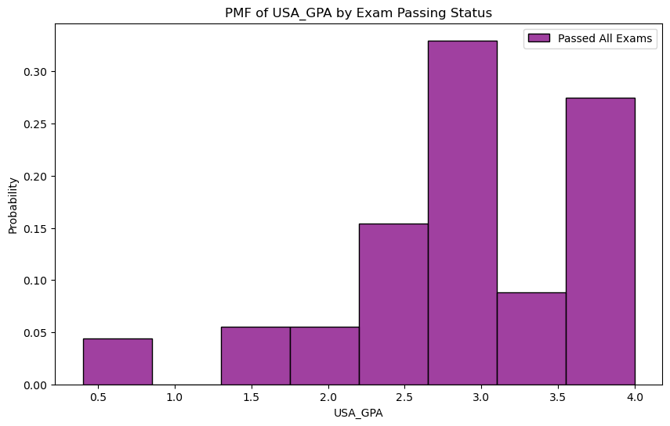
PMF Comparison
PMF Analysis: Peak of students passing
exams peaks at 3.0 followed by 4.0.
This indicates that students
passing exams are not
reliant on AI resources.
Notes:
PMF Comparison:
The Probability Mass Function (PMF) of USA_GPA for students who have passed all exams indicates a distribution where GPA scores are predominantly clustered around 3.0 and 4.0, with fewer students in the lower GPA ranges.
There is a clear peak at 3.0, suggesting that a significant number of students who passed all exams maintain a GPA at this level, indicating consistent academic performance.
Analysis:
High GPA Concentration: The PMF shows a high concentration of GPA scores at 3.0 and 4.0 for students who passed all exams, indicating strong overall academic performance and consistency in exam success.
Lower GPA Representation: There are very few students with GPA scores below 2.0 among those who passed all exams, suggesting that passing all exams is strongly correlated with maintaining a higher GPA.
Implications: The dataset implies that students who consistently pass all exams tend to have higher GPAs, which could reflect effective study habits, better understanding of course material, or other positive academic behaviors. This highlights the importance of exam performance as an indicator of overall academic success.

Slide 10
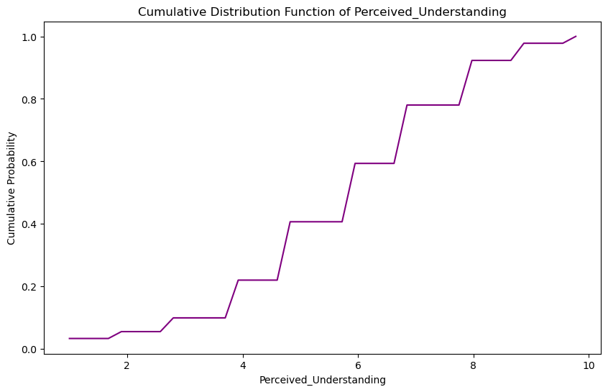
CDF Analysis
The majority of students feel they have a moderate understanding of AI capabilities.
Notes:
Perceived Understanding Distribution:
A significant portion of students rate their understanding of AI in the mid-range.
The CDF reaches a cumulative probability of 1 at the highest perceived understanding score, showing that all students fall within the range of 1 to 10 in their self-assessed understanding.
Relation: How do students perceive their understanding of AI, and how does this perception correlate with other factors such as performance, engagement, and outcomes?
The CDF suggests that most students feel they have a moderate to high understanding of AI, with fewer students rating their understanding at the extremes (very low or very high).
This distribution can help identify target groups for additional support or resources, especially those with lower self-assessed understanding.
The insights from the CDF can guide the development of tailored educational interventions to enhance AI literacy and ensure all students achieve a sufficient understanding level.

Slide 11
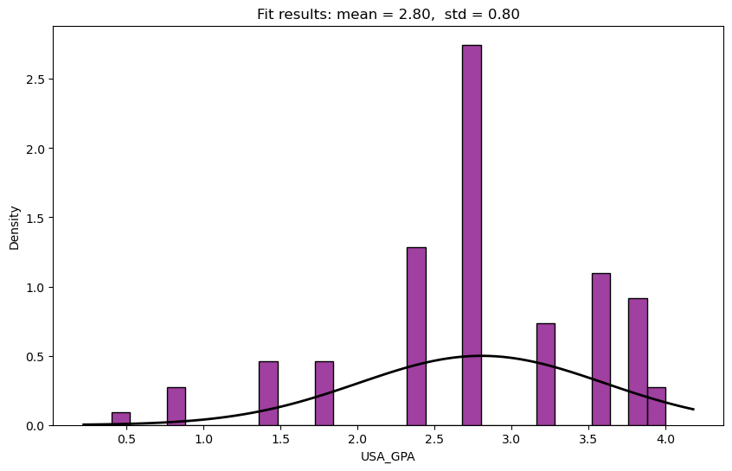
Analytical Distribution
Distribution Analysis: The USA_GPA histogram shows multiple peaks, especially around 2.5-3.0, deviating from the normal distribution.
Fit Assessment: The normal distribution doesn’t fully capture the variability in GPA data, suggesting a more complex model may be needed.
Notes:
Distribution Fit:
The distribution plot shows the analytical distribution (e.g., Normal distribution) overlaid on the histogram of USA_GPA.
The mean of the distribution is 2.80, and the standard deviation is 0.80.
Fit Assessment:
The analytical distribution does not perfectly fit the histogram of USA_GPA, as the data shows multiple peaks that deviate from a typical normal distribution.
There is a significant peak at the 2.5-3.0 GPA range, suggesting a higher concentration of students in this GPA bracket than what would be expected in a normal distribution.
The presence of several smaller peaks and valleys indicates variability that the normal distribution does not capture well.
Insights:
Non-Normal Distribution: The deviations from the normal distribution suggest that the GPA data is not normally distributed, indicating underlying factors or subpopulations within the student data that affect GPA distribution.
Skewness and Kurtosis: The distribution shows signs of positive skewness, with a longer tail towards higher GPA values, and higher kurtosis due to the prominent peak around 2.5-3.0.
Actionable Insights: Understanding that the GPA distribution is non-normal can guide further analysis using more appropriate statistical models or distributions that better capture the data's characteristics.

Slide 12
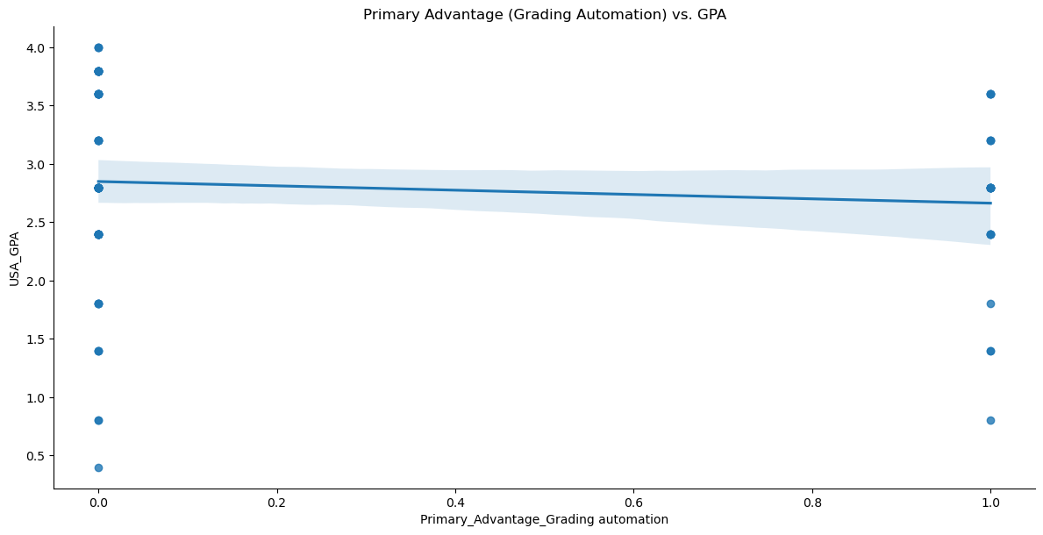
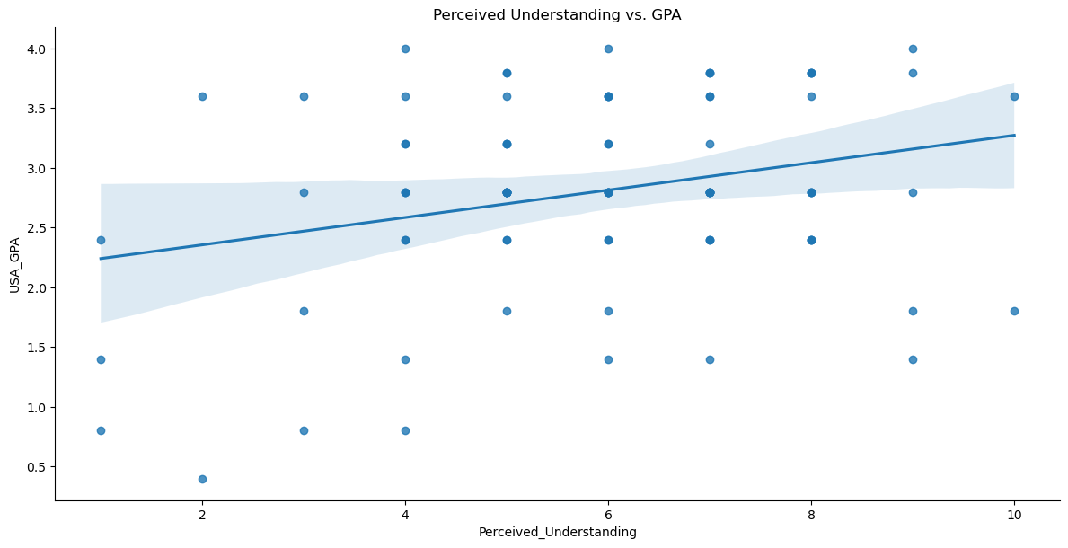
Scatter Plot Analysis
Perceived_Understanding vs. USA_GPA
Positive Trend: A slight positive correlation exists between perceived understanding and GPA.
High Variability: GPAs vary widely at similar perceived understanding levels.
Weak Correlation: The broad confidence interval indicates a weak relationship.
Primary_Advantage vs. USA_GPA
Slight Negative Trend: A minimal negative correlation is observed between grading automation as a primary advantage and GPA.
Clustered Data: Most data points are clustered at the extremes (0 and 1) with little variation in GPA.
Weak Relationship: The flat trend line and wide confidence interval suggest grading automation has little to no impact on GPA.
Scatter Plot Analysis
Notes:
Scatter Plot of Perceived_Understanding vs. USA_GPA
Analysis of Correlation and Causation:
The scatter plot shows the relationship between Perceived_Understanding and USA_GPA, with a trend line indicating the general direction of the relationship.
There is a slight positive trend, suggesting that as perceived understanding increases, GPA also tends to increase.
Discuss Covariance and Pearson’s Correlation:
Covariance measures the directional relationship between Perceived_Understanding and USA_GPA.
A positive covariance indicates that as Perceived_Understanding increases, USA_GPA also tends to increase.
In this dataset, the covariance is positive, suggesting a tendency for higher perceived understanding to be associated with higher GPA scores.
Pearson’s Correlation:
Pearson’s correlation coefficient quantifies the strength and direction of the linear relationship between Perceived_Understanding and USA_GPA.
The value of the correlation coefficient ranges from -1 to 1, where 1 indicates a perfect positive linear relationship, -1 indicates a perfect negative linear relationship, and 0 indicates no linear relationship.
In this analysis, the Pearson’s correlation coefficient is positive but relatively low, indicating a weak positive linear relationship between Perceived_Understanding and USA_GPA.
This weak correlation suggests that while there is a general trend of higher GPAs with increased perceived understanding, other factors may significantly influence GPA, and the relationship is not strong.
Slide 16: Scatter Plot of Primary_Advantage vs. USA_GPA
Analysis of correlation and causation.
Discuss covariance and Pearson’s correlation.

Slide 13
Scatter Plot Analysis
Perceived_Understanding vs. USA_GPA
Positive Trend: A slight positive correlation exists between perceived understanding and GPA.
High Variability: GPAs vary widely at similar perceived understanding levels.
Weak Correlation: The broad confidence interval indicates a weak relationship.
Primary_Advantage vs. USA_GPA
Slight Negative Trend: A minimal negative correlation is observed between grading automation as a primary advantage and GPA.
Clustered Data: Most data points are clustered at the extremes (0 and 1) with little variation in GPA.
Weak Relationship: The flat trend line and wide confidence interval suggest grading automation has little to no impact on GPA.
Scatter Plot Analysis
Notes:
Scatter Plot of Perceived_Understanding vs. USA_GPA
Analysis of Correlation and Causation:
The scatter plot shows the relationship between Perceived_Understanding and USA_GPA, with a trend line indicating the general direction of the relationship.
There is a slight positive trend, suggesting that as perceived understanding increases, GPA also tends to increase.
Discuss Covariance and Pearson’s Correlation:
Covariance measures the directional relationship between Perceived_Understanding and USA_GPA.
A positive covariance indicates that as Perceived_Understanding increases, USA_GPA also tends to increase.
In this dataset, the covariance is positive, suggesting a tendency for higher perceived understanding to be associated with higher GPA scores.
Pearson’s Correlation:
Pearson’s correlation coefficient quantifies the strength and direction of the linear relationship between Perceived_Understanding and USA_GPA.
The value of the correlation coefficient ranges from -1 to 1, where 1 indicates a perfect positive linear relationship, -1 indicates a perfect negative linear relationship, and 0 indicates no linear relationship.
In this analysis, the Pearson’s correlation coefficient is positive but relatively low, indicating a weak positive linear relationship between Perceived_Understanding and USA_GPA.
This weak correlation suggests that while there is a general trend of higher GPAs with increased perceived understanding, other factors may significantly influence GPA, and the relationship is not strong.
Slide 16: Scatter Plot of Primary_Advantage vs. USA_GPA
Analysis of correlation and causation.
Discuss covariance and Pearson’s correlation.

Slide 14
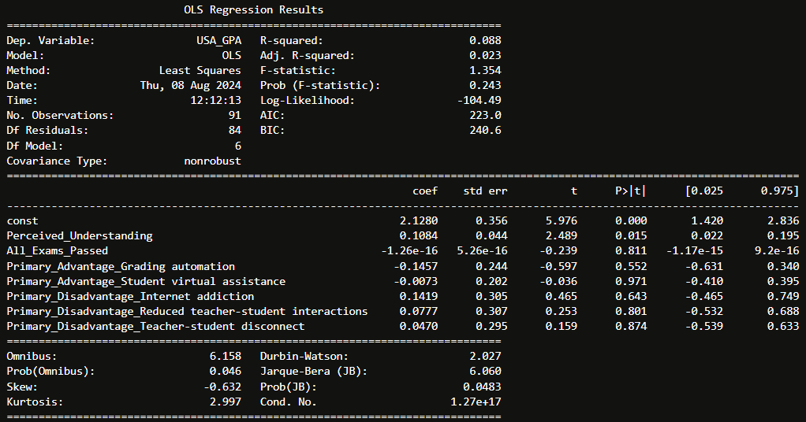
Regression Analysis
Model: OLS regression predicts USA_GPA using several factors.
Key Result: Perceived understanding positively impacts GPA (p = 0.015).
Fit: The model poorly explains GPA variance indicating other factors are likely more influential.
Notes:
Model:
The model used is an Ordinary Least Squares (OLS) regression to predict USA_GPA based on various independent variables.
Variables:
Dependent Variable: USA_GPA.
Independent Variables:
Perceived_Understanding
All_Exams_Passed
Primary_Advantage_Grading Automation
Primary_Advantage_Student Virtual Assistance
Primary_Disadvantage_Internet Addiction
Primary_Disadvantage_Reduced Teacher-Student Interactions
Primary_Disadvantage_Teacher-Student Disconnect
Results:
R-squared: 0.088, indicating that only 8.8% of the variance in USA_GPA is explained by the model, suggesting a weak fit.
Adjusted R-squared: 0.023, further reinforcing the weak explanatory power of the model.
Significant Predictors:
Perceived_Understanding: Statistically significant with a p-value of 0.015, suggesting that a higher perceived understanding is positively associated with GPA.
Non-Significant Predictors:
All other variables have high p-values, indicating no statistically significant relationship with USA_GPA.
Interpretation: The model reveals that while perceived understanding is positively associated with GPA, the overall model does not provide a strong prediction for GPA, indicating that other factors not included in the model may be more influential.

Slide 15
Conclusion
Findings suggest higher performing students also perceive having a higher understanding of AI.
Likewise, these students tend to pass all exams and are not reliant on AI.
More research is needed to understand how high performing students use AI today and how students prepare to use it in the future.
Notes:
Summary of Findings:
The analysis of the USA_GPA data highlighted a complex relationship between perceived understanding, exam performance, and various advantages and disadvantages of AI in education.
The PMF and CDF analyses revealed that while there is a general trend of higher GPA scores associated with greater perceived understanding and passing all exams, the distribution of GPA is not normally distributed, suggesting underlying variability in student performance.
The OLS regression model indicated that perceived understanding is a significant predictor of GPA, though the model as a whole explained only a small portion of the variance, pointing to the need for a more comprehensive approach to understanding GPA outcomes.
Implications:
The findings suggest that while perceived understanding and exam success are important, they are not the sole determinants of academic performance. Other factors, potentially outside the scope of this analysis, may play a crucial role in influencing GPA.
The weak fit of the regression model underscores the complexity of academic success and the need for more robust models or additional data to capture the full picture.
Next Steps:
Further research is recommended to explore additional variables and to develop more nuanced models that better capture the factors influencing GPA.
Educational interventions should be tailored to address both the cognitive (understanding and exam performance) and non-cognitive (motivation, support systems) aspects of student success.
Continuous monitoring and refinement of these strategies will be essential to improving educational outcomes and ensuring that students are well-equipped to succeed.
Final Thought:
By leveraging data-driven insights and continually adapting our approach, we can create more effective educational environments that support all students in achieving their academic potential.

Slide 16
Citations
Dimensional Insight. (2023, August 24). The artificial intelligence debate in education. Dimensional Insight. Retrieved from https://www.dimins.com/blog/2023/08/24/artificial-intelligence-debate-education/
Petrascu, G. M. (n.d.). Survey on students' perceptions of AI in education. Kaggle. Retrieved from https://www.kaggle.com/datasets/gianinamariapetrascu/survey-on-students-perceptions-of-ai-in-education

Slide 17
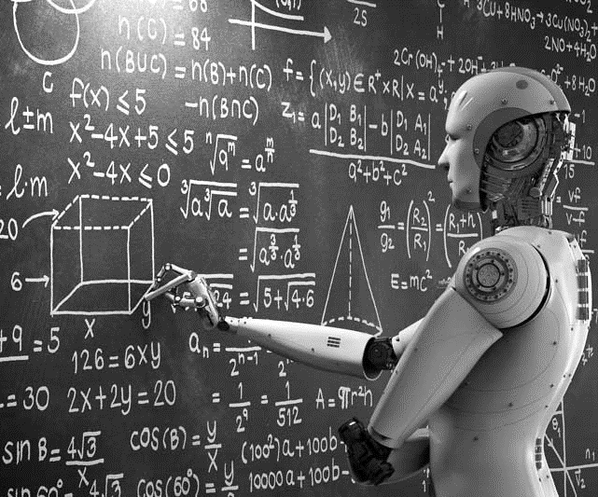
Notes:
https://www.dimins.com/blog/2023/08/24/artificial-intelligence-debate-education/

